Slide 1
Data Mesh

Slide 2
CONTENTS
01
What is a Data Mesh
Pg. No 03
02
what is Data Fabric
Pg. No 04
03 Data Mesh Benefits
Pg. No 05
04
Working of Data Mesh
Pg. No 06
05 Principle of Data Mesh
Pg. No 07
06
Data Mesh Architecture
Pg. No 09
07
Data Mesh Components
Pg. No 10
08 Data Mesh VS Data Fabric
Pg. No 11
09 Data Mesh Use Cases
Pg. No 12
10 Summary
Pg. No 13

Slide 3
What is Data Mesh
The Data Mesh is a new architectural paradigm for data management .
Proposed by the consultant Zhamak Dehghani in 2019 .
Based on the concepts of distributed system architectures.
Serve autonomous, domain-oriented teams.
Designed to address the historical failures of monolithic data architectures.
Manage autonomous interoperable data products(code, data, policy as one unit).
Data mesh is a new approach based on a modern, distributed architecture for analytical data management.
The main objective of data mesh is to eliminate the challenges of data availability at scale.

Slide 4
Data Fabric
Data Fabric democratizes data access across the enterprise, at scale.
It can be processed, managed and stored as it moves within the data fabric.
It is designed to help organizations solve complex data problems and use cases by managing their data.
Data Fabric combines key data management technologies.
It delivers integrated data to all data consumers.
It can provide a catalog of consistent data services private and public clouds.

Slide 5
Data Mesh Benefits
Business Agility and Scalability.
Platform Connectivity and Data Security.
Faster Access and Accurate Data Delivery.
Flexibility and Independence.
Robust Data Governance for End-to-End Compliance.
Cross-Functional Teams for improved Transparency.

Slide 6
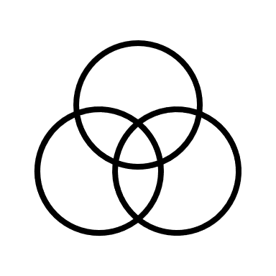
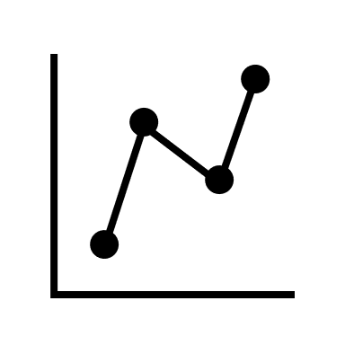
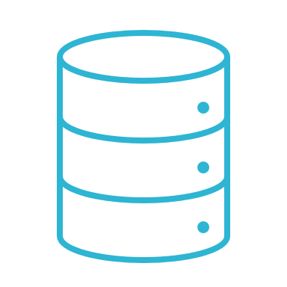






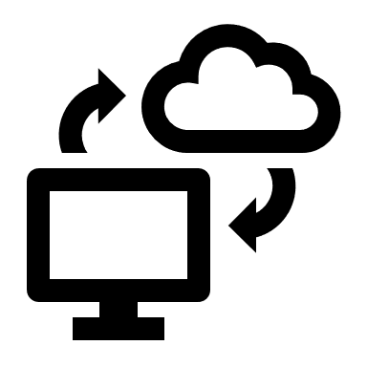
Working of Data Mesh
Trustgrid Data Mesh Platform
Data Center Database
Analytics Application
Application Database
Internet
BI Dashboards
Virtual Data Warehouse
Public Cloud Datastore
Data Catalogs
On-Premise Device
SaaS Application
Software –defined
Networking
Application Deployment
APIs
Distributed Data Sources
Applications

Slide 7

Principle of Data Mesh
The four principles of distributed architecture
Domain Ownership
1
A platform that enables autonomous domain teams to manage data end to end.
Data as a product
2
It is the concept of applying key product development principles to data projects.
Self-serv data platform
3
The aim is to empower business users and decision makers at all levels to use available data to their job effectively.
Federated
Computational
governance
4
Data governance ensures data is secure, accurate and not misused.

Slide 8

Data mesh architecture

Slide 9

Data Mesh Architecture
Federated governance
Amazon Web Services
Interoperability
Policy
Documentation policy
Security policy
Privacy policy
Compliance policy
Guide
Google Cloud
Consulting
Analytics
Example
Microsoft Azure
Analytical data
Data product
Domain
Data product
Operational Data
Best practices
Storage and query engine
Catalog
Access Management
Monitoring
Policy automation
Snowflake
.
Self-serve data platform

Slide 10
Data Mesh Components
Storage
Data Preprocessing
Metadata and Data Catalogs
BI Tools

Slide 11
Data Mesh Vs Data Fabric
Comparisons of Data Mesh and data Fabric
Data Mesh
Data Fabric
Focus on data architecture.
Focus on data architecture, semantic
Consumption, through the wide use of Ontologies.
Framework
Multiple governance layers.
Unified governance layers.
Governance
Security
Data Products owing the domain data and applying security and governance applicable to the domain.
Focuses on a comprehensive Unified
Security model across the entire data
Ecosystem.
Consistency
Complex mechanics to ensure
Consistency of data .
Focused on enabling and ensuring trust
By applying automatic consistency.
implementation
Data Mesh is complex.
By far simpler.

Slide 12
Data Mesh Use Cases
Data Mesh supports many different operational and analytical use cases, across multiple domains. Here are few examples.
Customer 360 View
01
to support customer care in reducing average handle time, increase first contact resolution, and improve customer satisfaction. A single view of the customer may also be deployed by marketing to predictive churn modeling or next-best-offer decisioning.
Hyper Segmentation
02
to enable marketing teams, deliver the right campaign to the right customer, at the right time, and via the right channel.
Data Privacy
Management
03
to protect customer data by complying with ever-emerging regional data privacy laws, like VCDPA, prior to making it available to data consumers in the business domains.
IoT device monitoring
04
providing product teams with insights into edge device usage patterns, to continually improve product adoption and profitability.
Federated data preparation
05
enabling domains to quickly provision quality, trusted data for their data analytics workloads.

Slide 13
Summary
Favor decentralized technologies.
Data Mesh is a new paradigm for storing data at the edge, managed by domain experts who craft and maintain the data products.
Data Mesh benefits and challenges for enterprise data management.
It allows business users and data scientist alike to access, analyze and operationalize business insights from virtually and data source, if any location, without intervention from expert data teams

